Slide 1

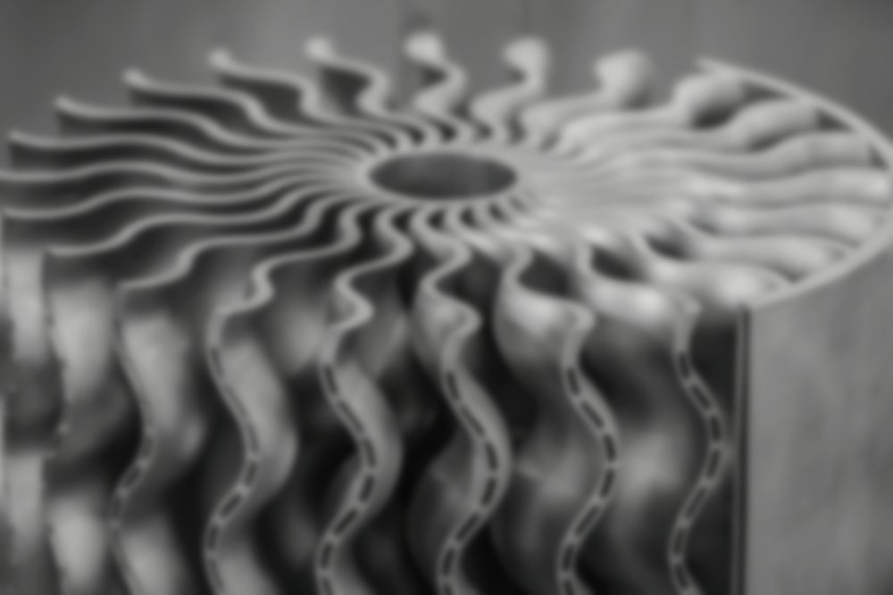
Acoustic monitoring in 3D printing
Group members:
Notes:
Good afternoon, professor. I will now proceed with my presentation. My project name is Integration of Computer Vision for Realtime Quality Control in 3D Printing of Pharmaceuticals.

Slide 2
1
Background
2
Objective
Content
3
Methods
4
Results
5
Conclusion
Notes:
Here is the content with 5 parts.

Slide 3
1
Background
Notes:
Then I am going to start with background.

Slide 4
Background
01
The rise of 3D printing in different fields
02
The importance of acoustic monitoring
Notes:
Thanks to some of its inherent advantages, 3D printing is becoming increasingly popular in different kinds of industries. At the same time, acoustic monitoring is essential during 3D printing operations.

Slide 5



Background
Personalized products
Production Efficiency
Excellent performance
Notes:
3D printing technology has three main advantages. First, it is more suitable for producing personalized products than traditional manufacturing. Second, it has higher production efficiency. Finally, products made with 3D printing technology often demonstrate excellent performance. This is why the technology is becoming increasingly popular.

Slide 6



Background
Real-time quality control
Increased production efficiency
Cost reduction
Notes:
Given this, studying acoustic monitoring in 3D printing is also very important. Here are the reasons. First of all, acoustic monitoring captures sound signals generated during key steps like melt pool formation and powder melting, reflecting process stability. By monitoring changes in these signals, potential defects can be detected in real-time, allowing for adjustments to printing parameters and ensuring print quality. In addition, acoustic monitoring helps quickly detect and identify abnormalities, preventing defect accumulation, reducing time and material waste due to print failures, and improving production efficiency. Then, the early warning capability of acoustic monitoring allows defects to be detected early in the manufacturing process, reducing scrap rates and lowering the costs associated with rework and material waste.

Slide 7
2
Objective
Notes:
The second part is objective.

Slide 8
Objective
Objective
Analyze the relationship between the manufacturing parameters and acoustic
signal in laser additive manufacturing processes
Predict the manufacturing parameters based on the acoustic signal
Notes:
As shown in the slide, our objective is to analyze the relationship between the manufacturing parameters and acoustic signal in laser additive manufacturing processes, and then predict the manufacturing parameters based on the acoustic signal.

Slide 9
3
Methods
Notes:
Then, methods.

Slide 10

Methods
Data-based/Machine learning approaches
Notes:
In this project, we mainly use the data-based approach or we call it machine learning approach.

Slide 11
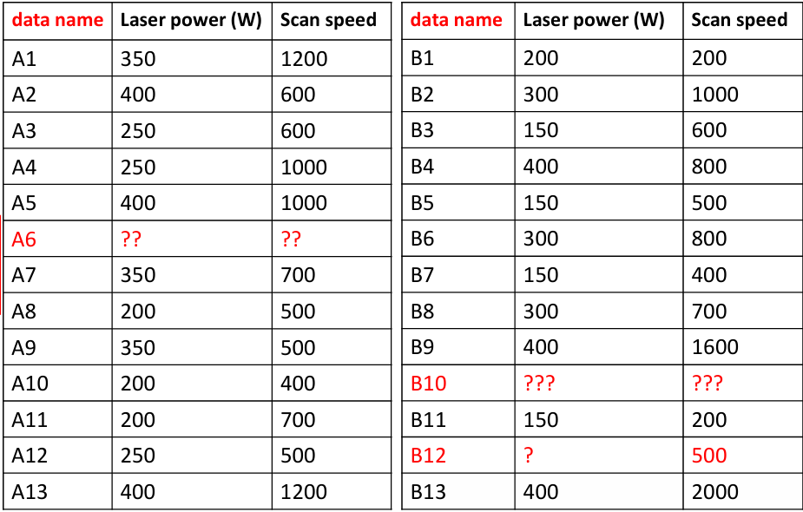
Methods
Notes:
Here are some data we can get from Professor Yan. We can see that there are 26 samples, each of them has two manufacturing parameters, laser power and scan speed. Three of the samples have incomplete data, and these are the data we need to predict later. We need to combine these data with the provided acoustic signals as the training set. At the same time, select some features to make the prediction more accurate.

Slide 12
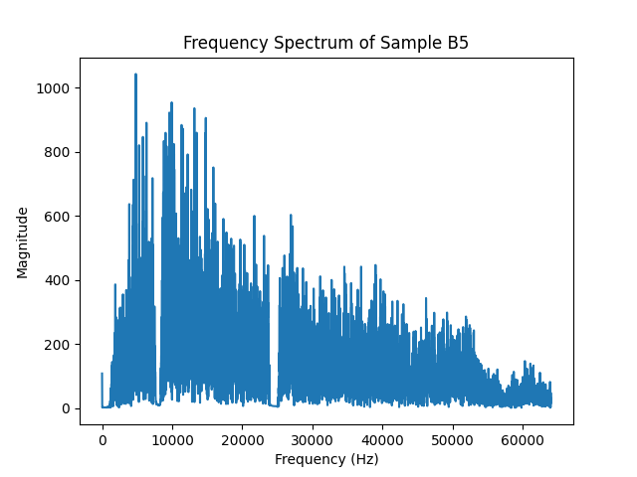
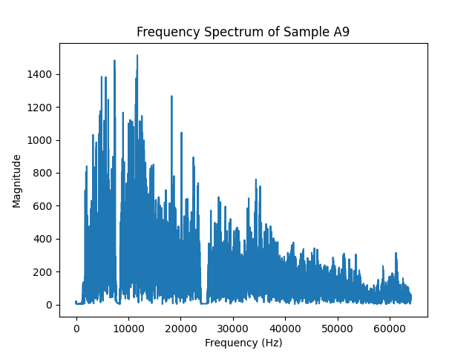
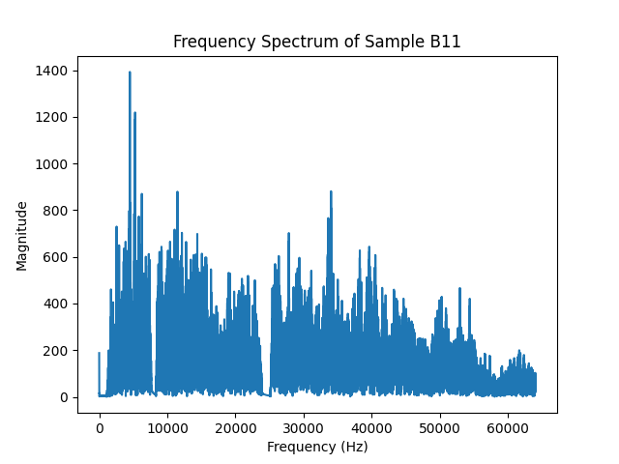
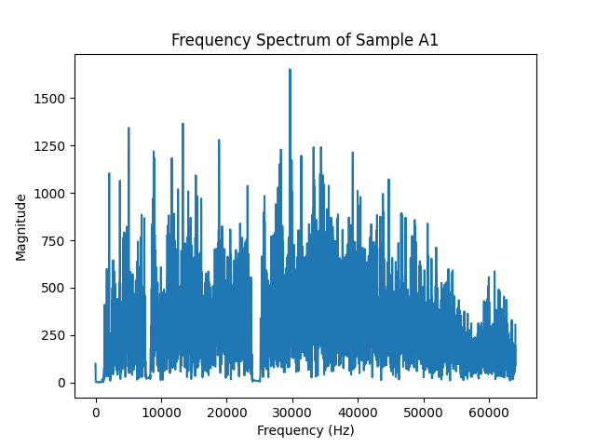
Laser power
Methods
B5 150 500
A9 350 500
B11 150 200
A1 350 1200
Notes:
Actually, we tried another approach, that is physics-based methods. The specific approach was to calculate the sound pressure of some interference terms using physical formulas, such as the sound generated by powder and spatter collisions, keyhole flow, and vapor jet formation. However, the formulas involved were too complex, with too many unknown parameters, which could easily lead to inaccurate data. Therefore, we ultimately did not adopt this method.

Slide 13
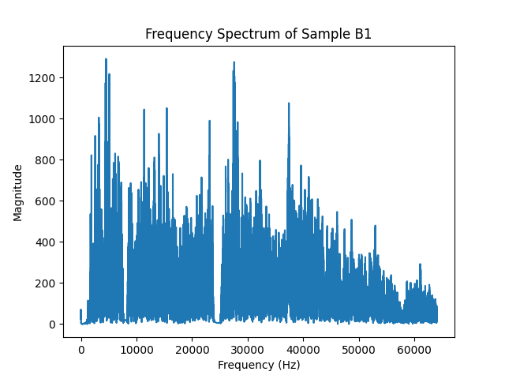
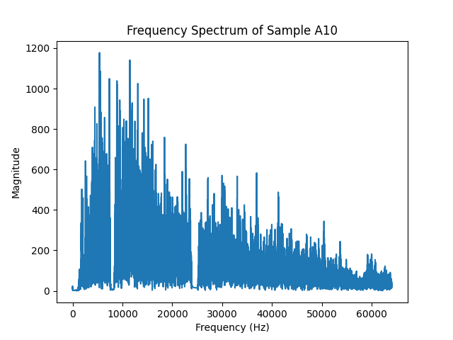
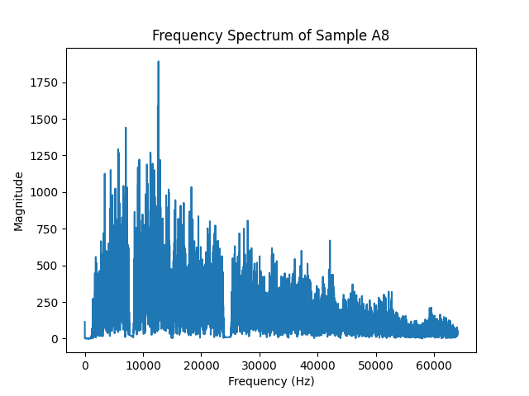
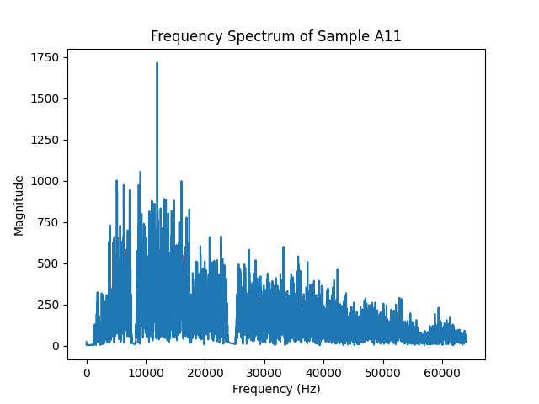
Laser power200
B1 200 200
A10 200 400
A8 200 500
A11 200 700
Notes:
Actually, we tried another approach, that is physics-based methods. The specific approach was to calculate the sound pressure of some interference terms using physical formulas, such as the sound generated by powder and spatter collisions, keyhole flow, and vapor jet formation. However, the formulas involved were too complex, with too many unknown parameters, which could easily lead to inaccurate data. Therefore, we ultimately did not adopt this method.

Slide 14
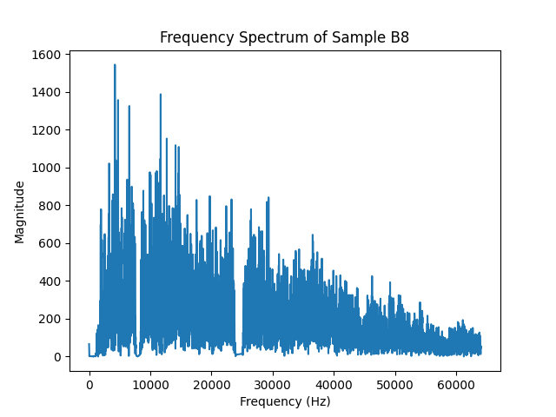
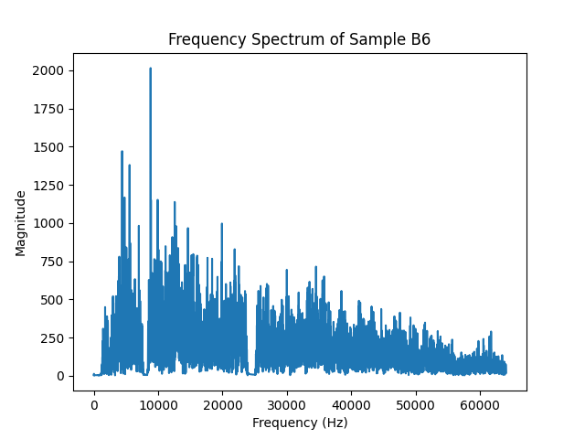
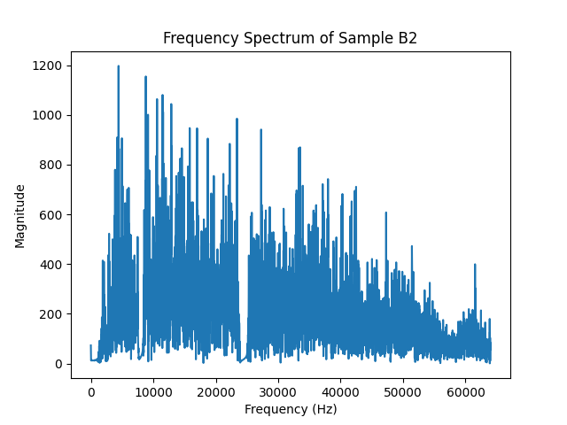
Laser power300
B8 300 700
B6 300 800
B2 300 1000

Slide 15
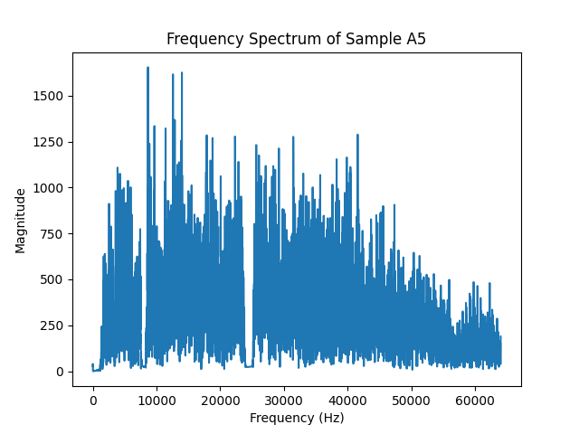
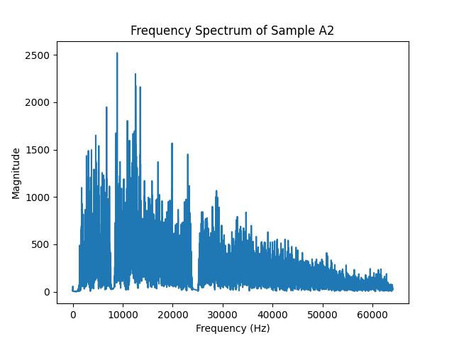
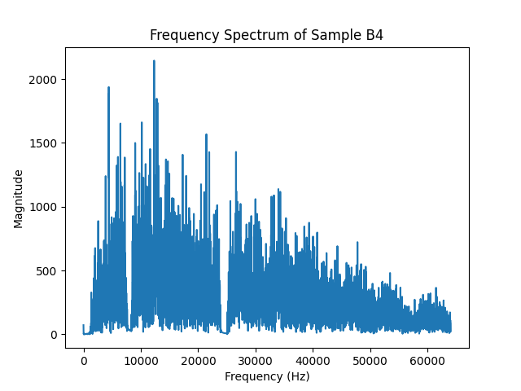
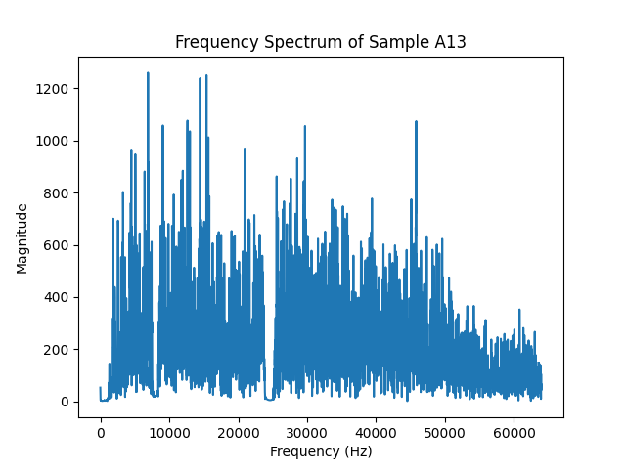
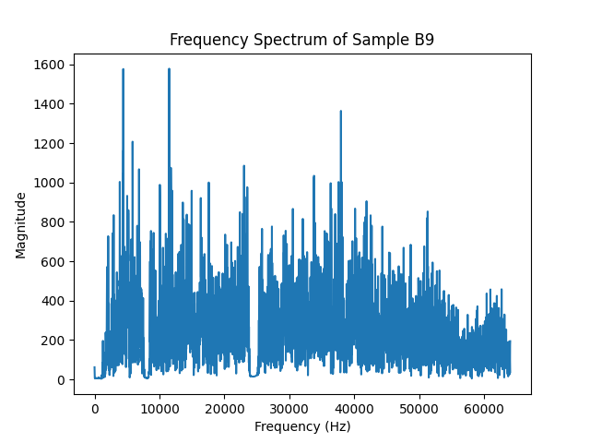
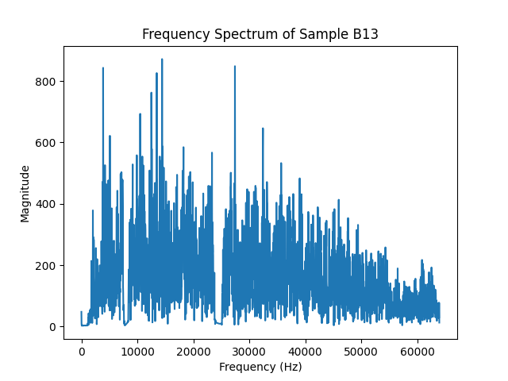
Laser power400
A2 400 600
B4 400 800
A5 400 1000
A13 400 1200
B9 400 1600
B13 400 2000

Slide 16
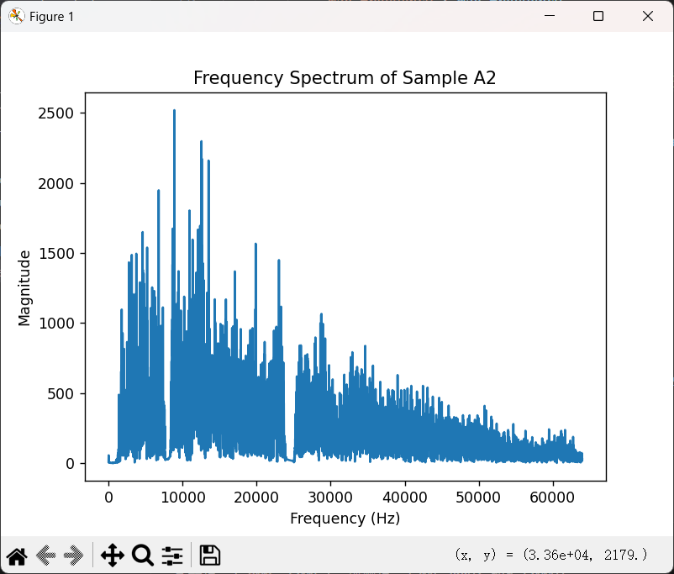
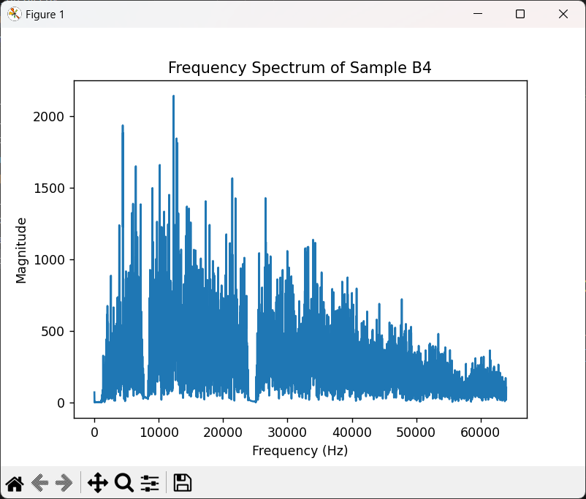
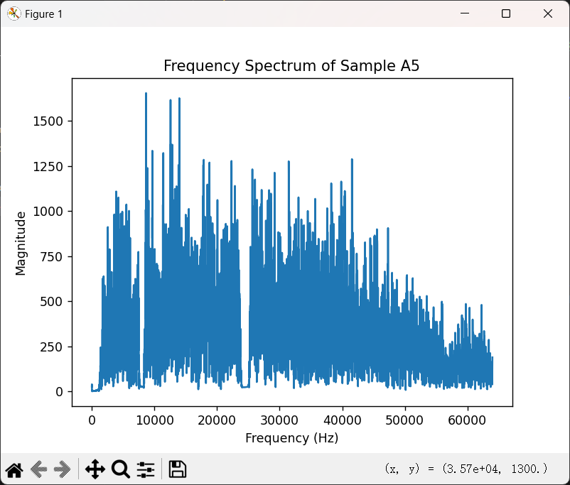
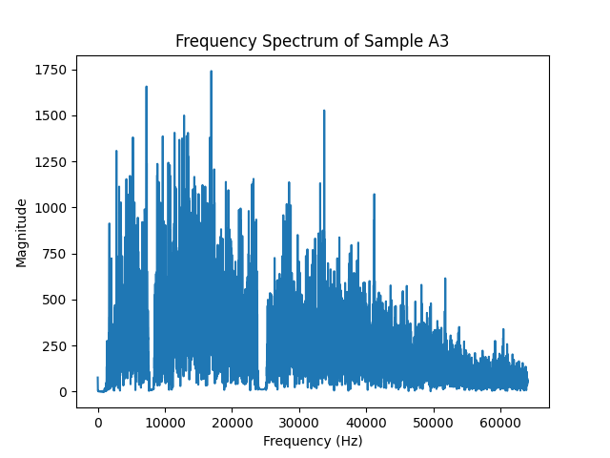
Scan speed 500
B9 B13 A13
'A2','B4','A5'
B11 A3 B1

Slide 17
Methods
Fourier transform
the energy distribution at different frequencies
频率特征比时间特征更能代表打印过程中的物理变化。
许多打印过程中的物理现象（如熔化、蒸气喷射、粉末碰撞）会产生特定频率的声学波动
Notes:
Actually, we tried another approach, that is physics-based methods. The specific approach was to calculate the sound pressure of some interference terms using physical formulas, such as the sound generated by powder and spatter collisions, keyhole flow, and vapor jet formation. However, the formulas involved were too complex, with too many unknown parameters, which could easily lead to inaccurate data. Therefore, we ultimately did not adopt this method.

Slide 18
Methods
平均频率的含义和作用：
定义：平均频率是所有频率的幅值加权平均，反映信号的“中心”频率。
作用：平均频率表示信号的频率分布重心，它能反映信号在打印过程中是偏向高频还是低频。例如：
高激光功率可能会导致高温熔化，产生更多高频成分，从而提高平均频率。
较低的激光功率或较慢的扫描速度，可能使信号偏向于低频，降低平均频率。
最大幅值对应的频率
定义：在频谱中具有最大幅值的频率，即能量最强的频率成分。
物理含义：
熔池振动：激光功率影响熔池的大小和振动频率，导致信号的主能量集中在某个频率上。较高的功率会使熔池形成更强的振动，进而在较高的频段上产生峰值。
粉末碰撞：高功率和高速度使得粉末与材料表面之间的碰撞频率增加，导致主频段上幅值增加。
Notes:
Actually, we tried another approach, that is physics-based methods. The specific approach was to calculate the sound pressure of some interference terms using physical formulas, such as the sound generated by powder and spatter collisions, keyhole flow, and vapor jet formation. However, the formulas involved were too complex, with too many unknown parameters, which could easily lead to inaccurate data. Therefore, we ultimately did not adopt this method.

Slide 19
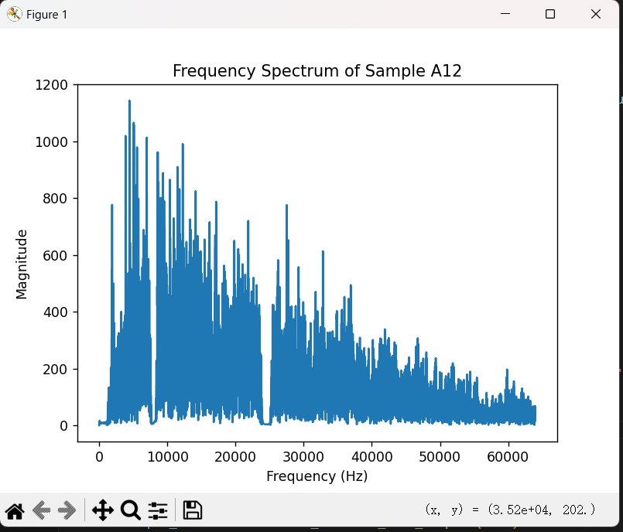
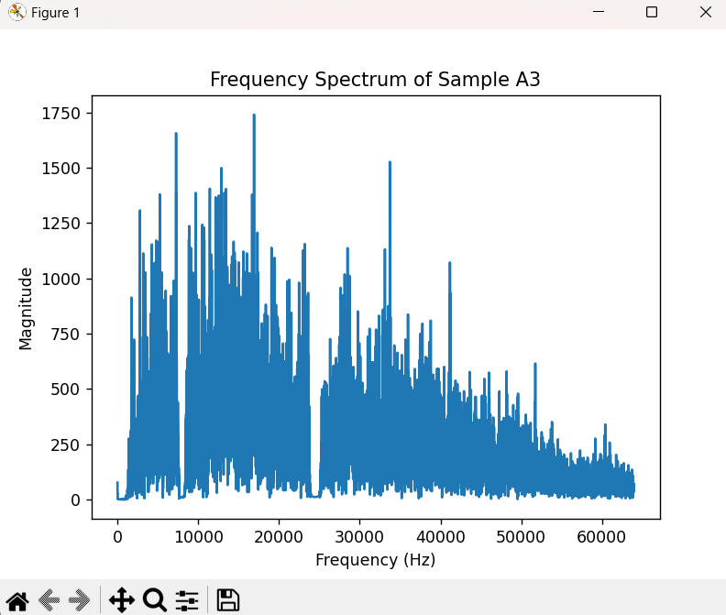
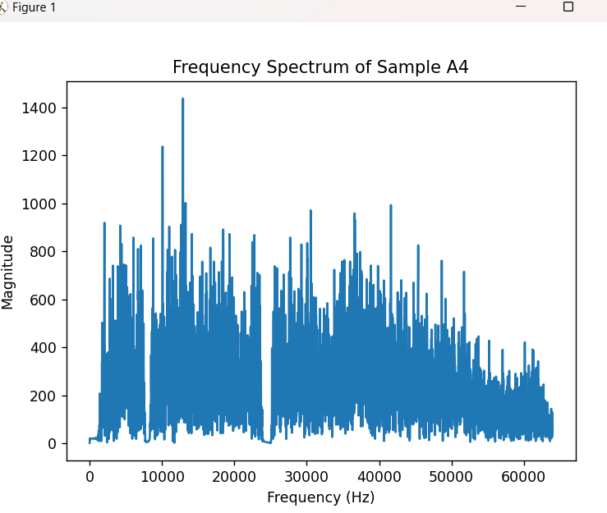
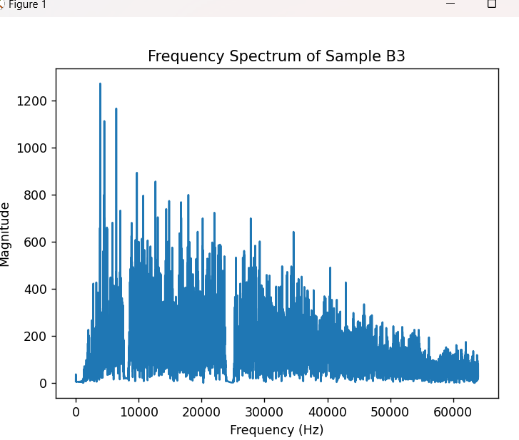

Notes:
Next is the results.

Slide 20
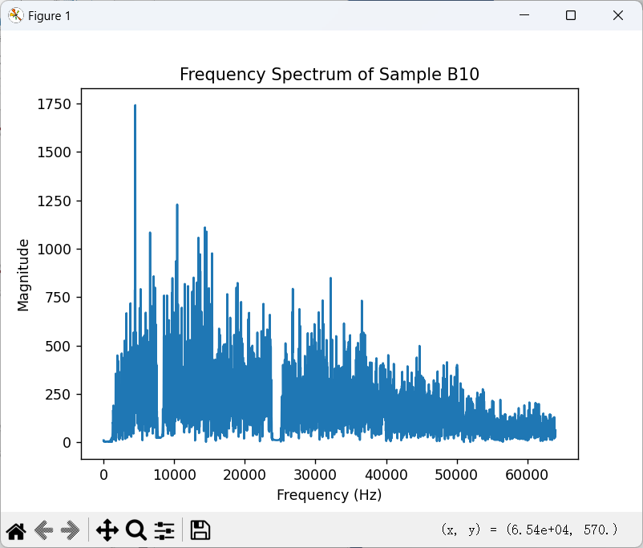
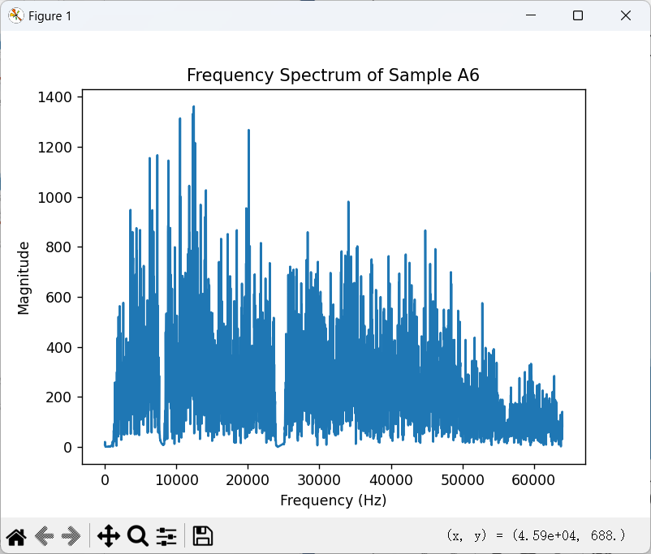
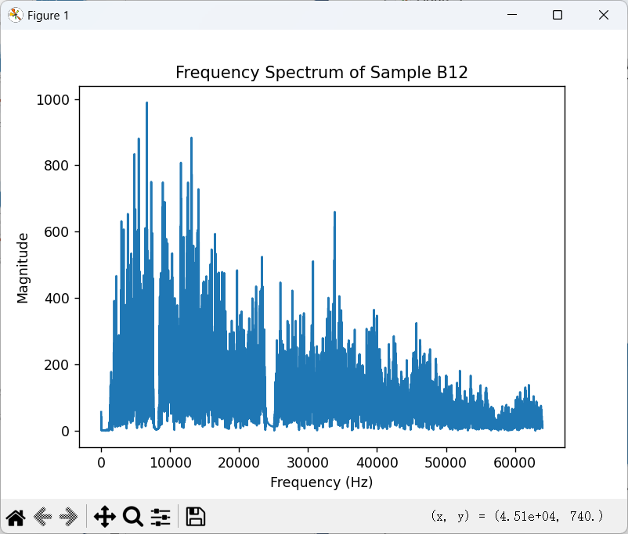
Results

Slide 21
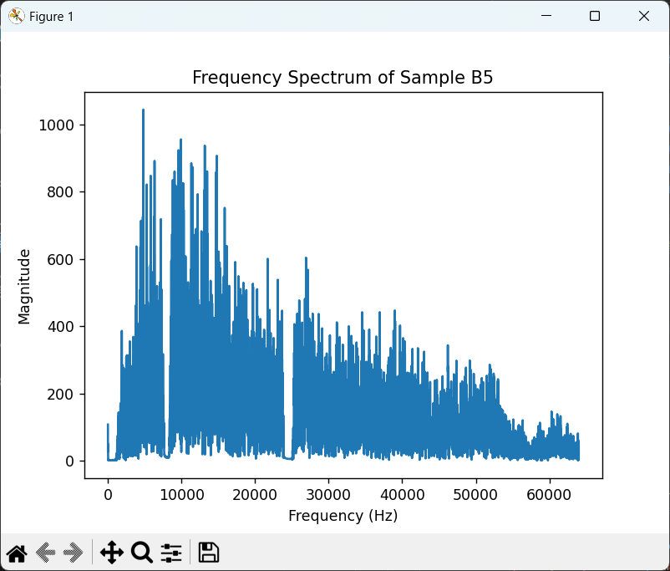
Results

Slide 22
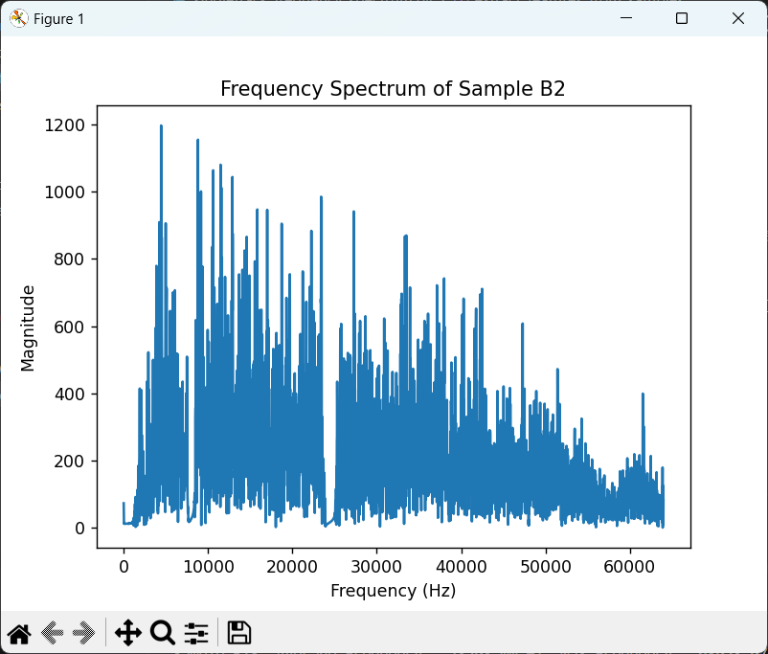
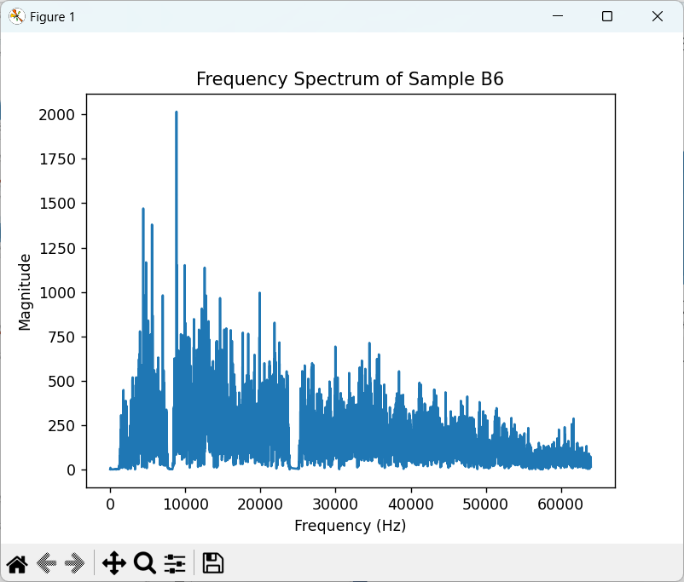

Results

Slide 23



Results

Slide 24
5
Conclusion
Notes:
Last is our conclusion.

Slide 25

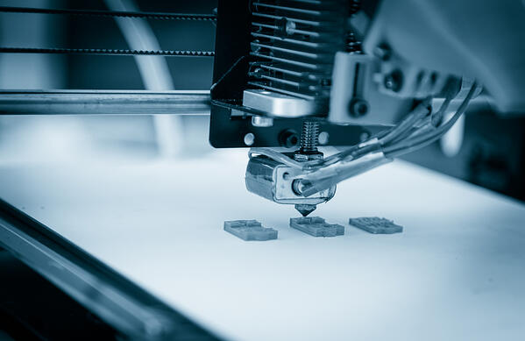
Conclusion
Tasks that still need to be done
The first thing to do is to solve the problem about webcam stream.
The next step is to find the best place for the camera.

Slide 26
Thanks
Notes:
And that’s all. Thank you.

